Slide 1
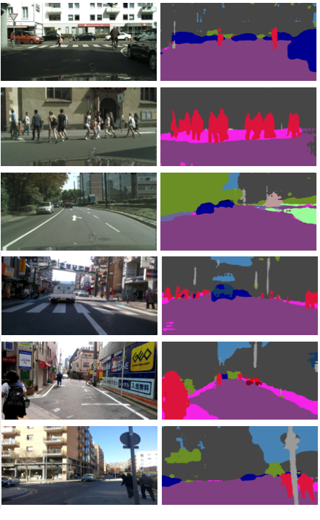
Real-Time Anomaly Segmentation for Road Scenes
Scaturro Andrea Pio, Lucca Gabriele, Martini Matteo

Slide 2
What is Anomaly Segmentation?
Anomaly segmentation refers to the process of identifying and delineating regions within data that deviate significantly from the expected or normal patterns. In the context of real-time monitoring, anomaly segmentation plays a vital role in detecting irregularities such as in road scenes.

Slide 3
01
Objectives
of the project

Slide 4
Our goals
To provide an effective and efficient solution for anomaly segmentation in road scenes, while ensuring the practicality and scalability of the models.
To present a thorough analysis of methodologies for real-time anomaly segmentation, focusing on the use of lightweight deep learning models.
To evaluate the effectiveness of models such as ERFNet, ENet, and BiSeNet, using various test datasets including Road Anomaly, Road Obstacle, and Fishyscapes.
To explore the impact of temperature scaling for model confidence calibration.
To investigate loss functions and pruning strategies to enhance the efficiency and effectiveness in the models

Slide 5
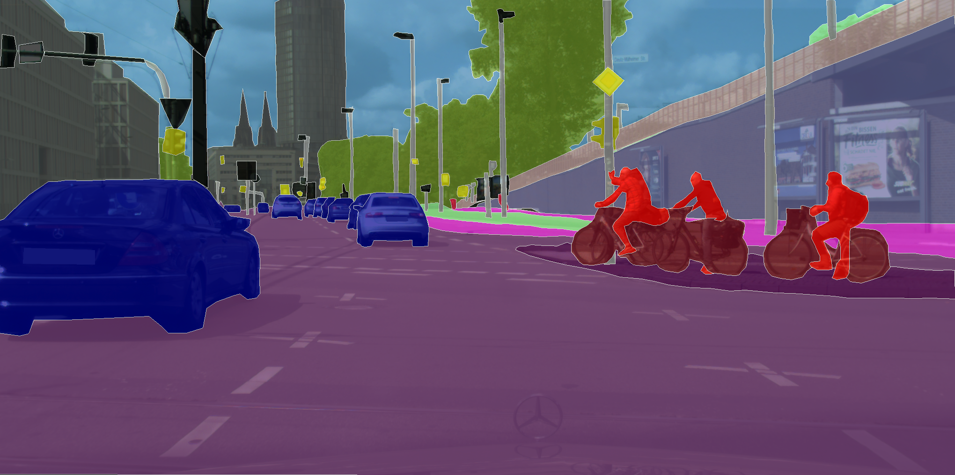
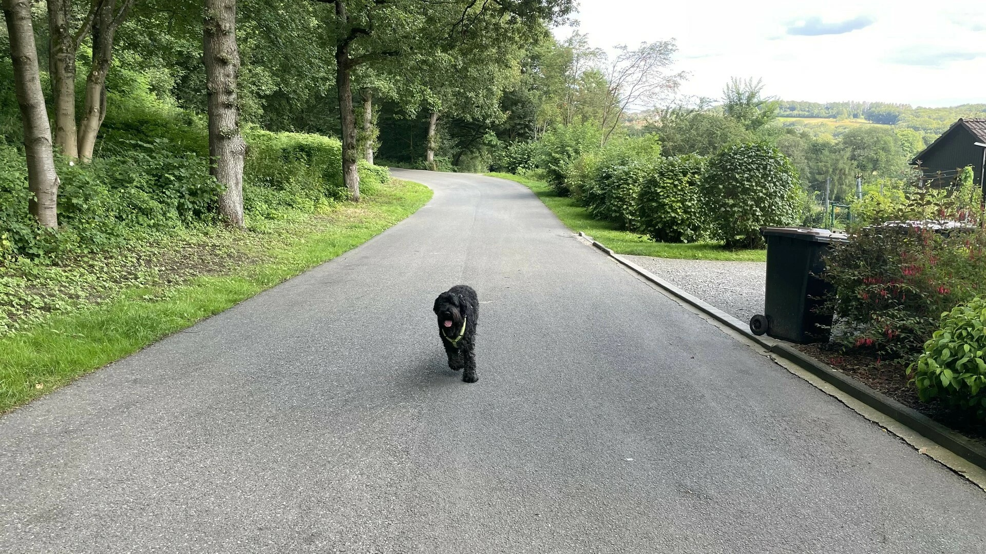
Datasets
Cityscapes
Cityscapes is a large dataset commonly used for training artificial vision models, especially for semantic segmentation and object detection in urban context.
It contains a vast set of high-resolution images acquired in 50 different cities, annotated with semantic labels for roads, sidewalks, buildings, vehicles, people, and other urban objects.
To increase diversity, the images were collected in different seasons of the year and under good/medium weather conditions.
RoadObstacle
RoadObstacle dataset is specifically designed for detecting obstacles on roads. It contains images of various road and environmental conditions, with a particular emphasis on the presence of obstacles such as debris, abandoned vehicles, construction work, and other potential hazards. The images are annotated with detailed information about the obstacles present.

Slide 6
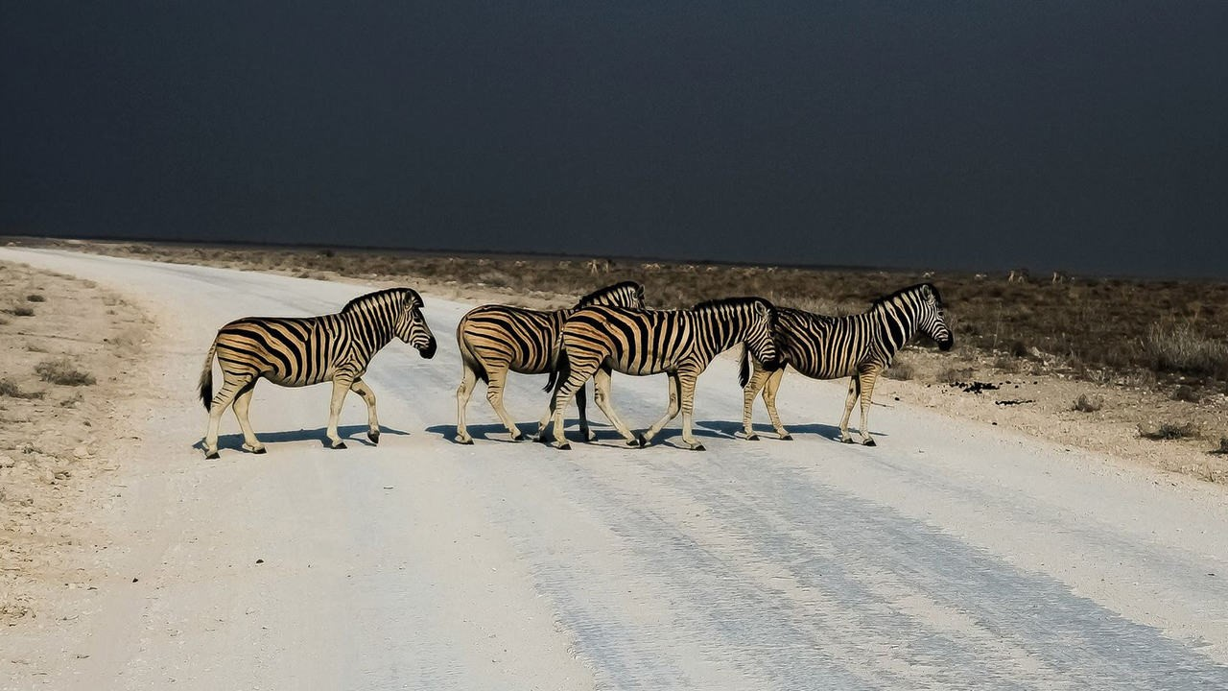

Datasets
RoadAnomaly
RoadAnomaly is a dataset focused on identifying anomalies and non-standard conditions on roads. This dataset contains a wide range of images representing atypical situations such as potholes, cracks, damaged road signs, and other irregularities that can affect traffic safety and flow.
Fishyscapes
The scapes benchmark for spotting anomalies uses images with "cut and paste" anomalies taken from different contexts. This can be a problem because the anomalies stand out too much and seem unnatural in the picture. To make the anomalies more realistic and harder to spot, they are placed in the scene with lighting and position similar to real anomalies.

Slide 7
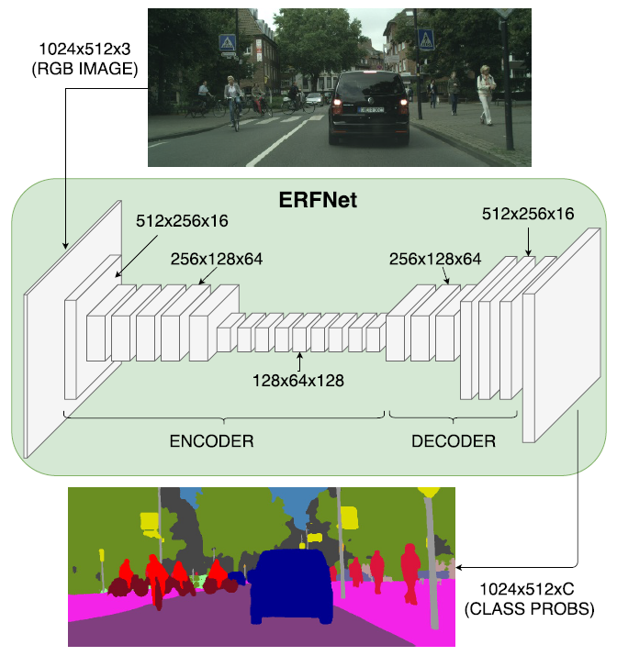
ERF-NET
"ErfNet: Efficient Residual Factorized Network"
Designed for real-time and precise semantic segmentation tasks.
Sequential organization into an encoder-decoder architecture. Small decoder.
Integration of residual blocks for deep representation learning and design with skip connections.
Optimized efficiency with factorized convolutions, reducing parameters and computational complexity.
Key strength: Exceptional computational efficiency, ideal for real-time applications.

Slide 8
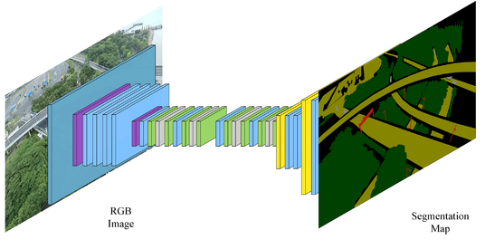
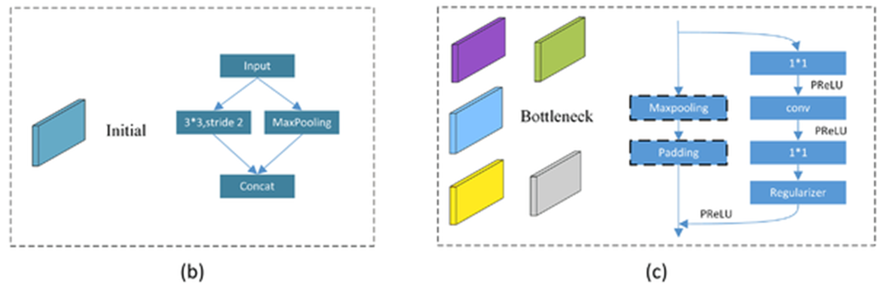
E-NET
"ENet: Efficient Neural Network"
Designed for for tasks requiring low latency operation.
Large decoder, small decoder.
Bottleneck modules, with 1 or 2 branches.
Their outputs are concatenated along the depth dimension.
Very fast, can process the images in real-time on embedded platforms

Slide 9
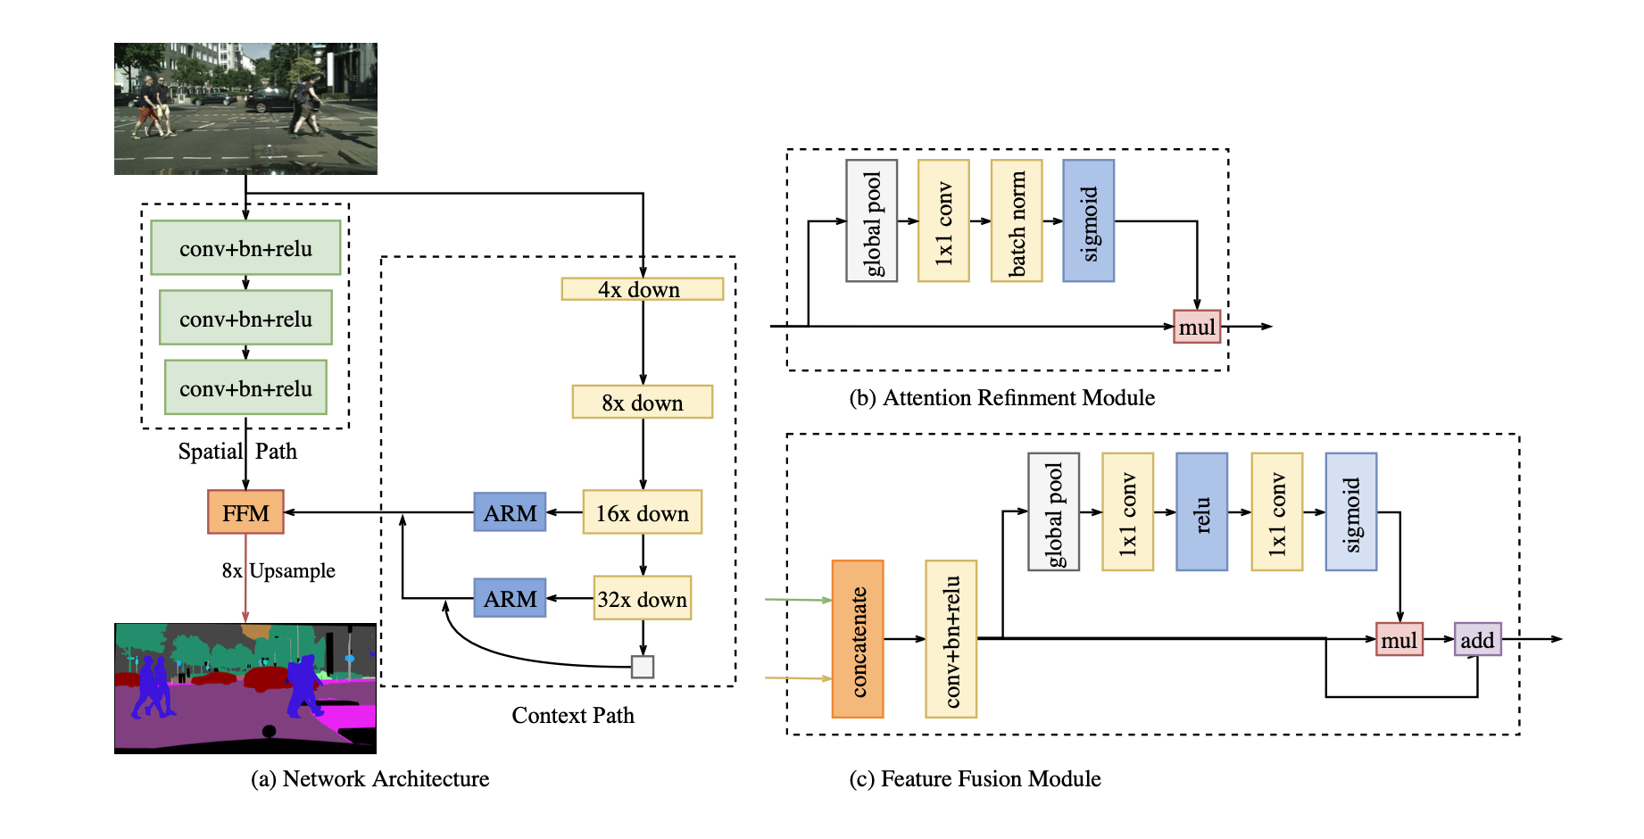
BiSe-NET
"BiSeNet: Bilateral Segmentation Network"
Proposed to enhance speed and accuracy of real-time semantic segmentation.
Consists of two paths: Spatial Path (SP) preserves spatial information, while Context Path (CP) capture and incorporate contextual information at various spatial scales.
Contextual features at different scales are then fused together to obtain an overall representation of the image context. Feature Fusion Module(FFM) to combine features & Attention Refinement Module(ARM) to refine the features of each stage.
However, may demand more computational
resources compared to more efficient architectures like ERFNet and ENet, limiting suitability for embedded devices or real-time scenarios.

Slide 10
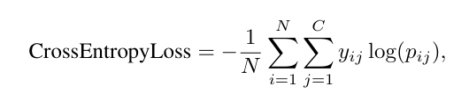
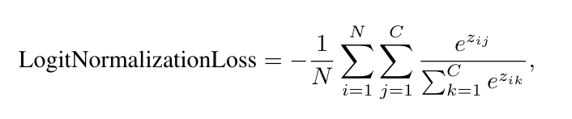
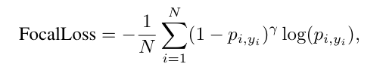
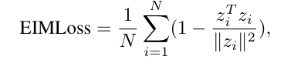
Losses
Cross-entropy loss
Logit Normalization Loss
Cross-entropy loss is a commonly used loss function for classification tasks. It quantifies the dissimilarity between the predicted probability distribution and the actual distribution of the target classes.
The Logit Normalization Loss is designed to address the issue of class imbalance in classification tasks. It normalizes the logits of each class to mitigate the impact of heavily weighted classes on the training process.
Focal loss
Enhanced Isotropy Maximization Loss
Focal Loss is particularly effective for addressing class imbalance and the issue of easy and hard examples in classification tasks. It introduces a modulating factor to down-weight the loss assigned to well-classified examples, thereby focusing more on the difficult examples.
The Enhanced Isotropy Maximization Loss is a loss function designed to enhance the isotropy of feature representations learned by neural networks. By encouraging feature vectors to have similar magnitudes, this loss function aims to improve the generalization performance of the model.

Slide 11
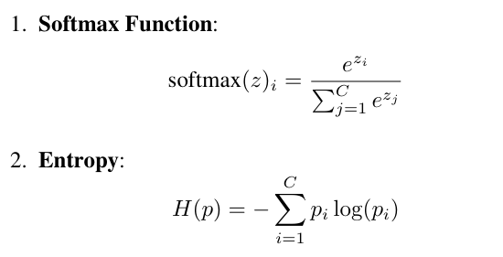
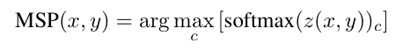
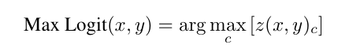
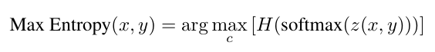
Methods
Entropy and Softmax
MSP
MSP (Maximum Softmax Probability) is a method employed in semantic image segmentation to determine the predicted class for each pixel based on the maximum probability obtained through the softmax function. Mathematically, for each pixel in the image, the class with the highest probability predicted by the neural network is selected.
Max Logit
Max Entropy
Max Logit entails selecting the predicted class for each pixel based on the maximum value among the outputs of the neural network, without the application of the softmax function. Essentially, the class with the highest logit (i.e., the output of the neural network before softmax) is directly chosen for each pixel.
Max Entropy relies on the entropy of the probability distribution obtained from the softmax function. For each pixel in the image, the class that maximizes the entropy of the probability distribution is selected, indicating the class with the highest uncertainty in prediction.

Slide 12
02
Experiments
and Results

Slide 13
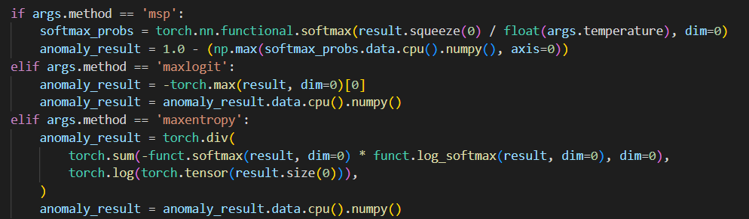
Experiments
Pre-trained ERF-Net model
We use a pre-trained ERF-Net model, trained on the Cityscapes dataset as a baseline for our experiments.
 |  | SMIYC RA-21 |  | SMIYC RO-21 |  | FS L&F |  | FS Static |  | Road Anomaly
Method | mIoU | AuPRC | FPR95 | AuPRC | FPR95 | AuPRC | FPR95 | AuPRC | FPR95 | AuPRC | FPR95
MSP | 72.20 % | 14.5854 | 95.0901 | 0.7207 | 94.7685 | 0.2678 | 95.8130 | 1.9816 | 95.2585 | 9.4270 | 95.3010
MaxLogit | 72.20% | 13.1934 | 97.0150 | 1.1526 | 86.8155 | 0.21394 | 96.4409 | 1.6452 | 96.4614 | 8.7079 | 93.7640
Max Entropy | 72.20% | 14.3098 | 96.7160 | 0.8318 | 94.0838 | 0.2374 | 96.8159 | 1.9526 | 94.0524 | 9.1069 | 95.3125

Slide 14
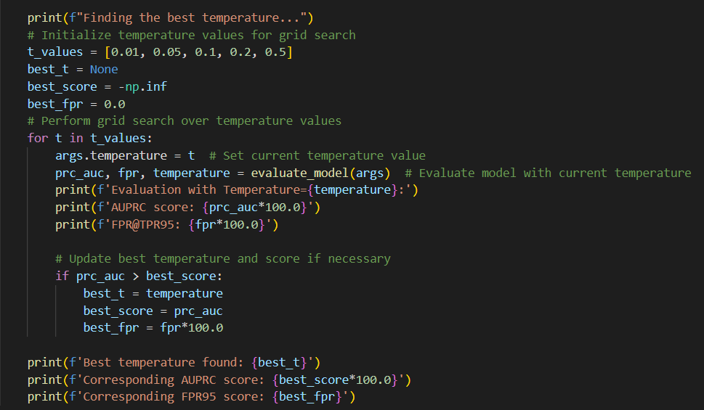
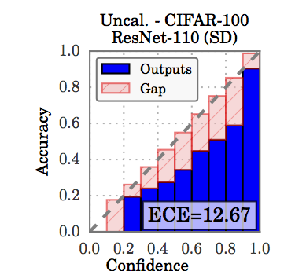
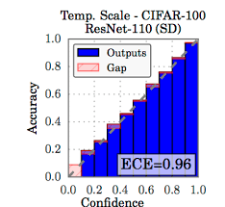
Experiments
Effect of Temperature scaling
Temperature scaling, a method for confidence calibration, was employed to potentially enhance the anomaly segmentation capabilities of the network. Our objective in this stage was to determine the optimal temperature value that yields the most effective anomaly segmentation results during inference.
eval/best_temperature.py, 54

Slide 15
Experiments
Effect of Temperature scaling
Temperature scaling, a method for confidence calibration, was employed to potentially enhance the anomaly segmentation capabilities of the network. Our objective in this stage was to determine the optimal temperature value that yields the most effective anomaly segmentation results during inference.
 |  | SMIYC RA-21 |  | SMIYC RO-21 |  | FS L&F |  | FS Static |  | Road Anomaly
Method | mIoU | AuPRC | FPR95 | AuPRC | FPR95 | AuPRC | FPR95 | AuPRC | FPR95 | AuPRC | FPR95
MSP | 72.20 % | 14.5854 | 95.0901 | 0.7207 | 94.7685 | 0.2678 | 95.8130 | 1.9816 | 95.2585 | 9.4270 | 95.3010
MSP(t = 0.5) | 72.20% | 14.6748 | 95.0522 | 0.6988 | 94.8856 | 0.2793 | 95.3960 | 2.0169 | 95.1832 | 9.6063 | 95.1719
MSP(t = 0.75) | 72.20% | 14.6263 | 95.0723 | 0.7100 | 94.8268 | 0.2732 | 95.6029 | 1.9962 | 95.2266 | 9.5094 | 95.2439
MSP(t = 1.1) | 72.20% | 14.5704 | 95.0976 | 0.7248 | 94.7454 | 0.2658 | 95.8959 | 1.9765 | 95.2674 | 9.3979 | 95.3194
MSP (best t) | 72.20% | 14.80676 (t=0.0001) | 94.9999 (t=0.0001) | 0.6754 (t=0.01) | 94.9969 (t=0.01) | 0.2828 (t=0.0001) | 95.0000 (t=0.0001) | 2.0838 (t=1e-06) | 94.9999 (t=1e-06) | 9.8495 (t=1e-05) | 95.0000 (t=1e-05)

Slide 16
Experiments
Implementing the void classifier
The Cityscapes dataset include 19 known category classes along with a void (background) class. We treated the void class as an anomaly and proceeded to train ENet and BiSeNet networks accordingly. Subsequently, during anomaly inference, only the output of the void class was considered, serving as another baseline for our experimentation. We fine-tuned using pre-trained model classes with 20 epochs.
 |  | SMIYC RA-21 |  | SMIYC RO-21 |  | FS L&F |  | FS Static |  | Road Anomaly
Network | mIoU | AuPRC | FPR95 | AuPRC | FPR95 | AuPRC | FPR95 | AuPRC | FPR95 | AuPRC | FPR95
ENet | 58.60% | 14.5938 | 95.1338 | 0.6718 | 95.1184 | 0.2750 | 95.2099 | 2.0935 | 94.8343 | 9.7372 | 95.0344
ERF-Net | 71.62 % | 14.7575 | 94.4175 | 0.8064 | 94.3740 | 0.2532 | 96.0658 | 2.4870 | 92.0668 | 9.0139 | 94.9432
BiSeNet | 43.76% | 23.4244 | 95.5064 | 2.7488 | 99.8951 | 0.3649 | 95.1364 | 1.9309 | 89.9654 | 12.6709 | 96.0435

Slide 17
Experiments
Studying the effect of training loss function
We investigated the impact of specific loss functions tailored for anomaly detection on the training process. We wanted to analyze the effects of the Logit Normalization Loss when employed individually and in conjunction with focal loss and cross-entropy loss. Unfortunately, the Enhanced Isotropy Maximization Loss was not suitable for our problem so we discarded it.
We also analyzed another loss, which is the linear combination of the possible losses we used in the other experiments. For each loss function and available method, we conducted 50 epochs.
Example: Focal Loss
mIoU= 62.33% | SMIYC RA-21 |  | SMIYC RO-21 |  | FS L&F |  | FS Static |  | Road Anomaly
Method | AuPRC | FPR95 | AuPRC | FPR95 | AuPRC | FPR95 | AuPRC | FPR95 | AuPRC | FPR95
MSP | 13.9849 | 95.6219 | 0.5752 | 96.6891 | 0.2520 | 96.1628 | 2.2168 | 92.6406 | 10.2030 | 94.7492
Max Entropy | 13.3582 | 99.0708 | 0.4758 | 99.0867 | 0.2489 | 95.4395 | 2.1685 | 91.8139 | 10.4629 | 92.2233
MaxLogit | 15.5002 | 99.5639 | 0.4730 | 99.4214 | 0.2567 | 97.3257 | 1.8476 | 93.8357 | 10.3386 | 94.4091
Void | 20.1531 | 91.8372 | 0.8406 | 95.2570 | 0.5042 | 94.0883 | 1.8079 | 93.7700 | 10.3610 | 94.4803

Slide 18
Experiments
Effect of pruning and quantization
To make the model smaller and faster, we investigated methods like pruning and quantization on the models. The outcomes of our experiments included metrics such as mean Intersection over Union (mIOU), Floating Point Operations per Second (FLOPS), the number of trainable model parameters, and how well the model performed in spotting anomalies. We trained the models for 50 epochs, and every 10 epochs, we removed the least impactful 10% of the weights.
mIoU=41.73% | SMIYC RA-21 |  | SMIYC RO-21 |  | FS L&F |  | FS Static |  | Road Anomaly
Method | AuPRC | FPR95 | AuPRC | FPR95 | AuPRC | FPR95 | AuPRC | FPR95 | AuPRC | FPR95
MSP | 16.6829 | 94.1869 | 0.6766 | 94.9483 | 0.3299 | 94.5960 | 2.0814 | 90.3079 | 9..6481 | 91.5028
Max Entropy | 17.8747 | 92.0277 | 0.8583 | 84.4113 | 0.3398 | 90.4530 | 2.0185 | 85.1242 | 12.9739 | 72.6023
MaxLogit | 18.3697 | 96.3537 | 0.8337 | 83.3651 | 0.4480 | 90.0608 | 1.5364 | 89.4773 | 13.9256 | 73.5770
Void | 18.2554 | 93.5158 | 0.7617 | 94.0725 | 0.3549 | 91.3122 | 1.3890 | 96.3515 | 12.3362 | 84.9841

Slide 19
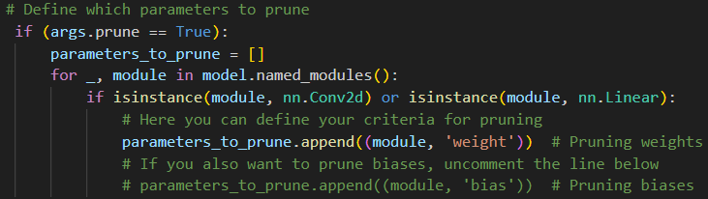
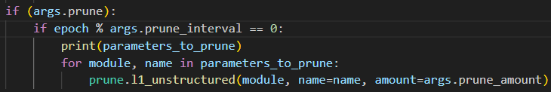
Experiments
train/main.py, 216
train/main.py, 370

Slide 20
03
Considerations

Slide 21
Our considerations
By using pre-trained ERF-Net model:
With MaxEntropy, the results fell short of expectations because of the small size of the proposed networks.
MSP showed a better fit for the proposed problem, likely because of its simplicity and suitability for small-scale architectures.
MaxLogit yielded the poorest results, emphasizing the importance of considering the characteristics of the task and the model’s capacity.
By studying the effect of Temperature scaling:
the application of temperature scaling did not significantly improve performance, indicating the complexity of enhancing the network’s predictive capabilities within the constraints of its architecture.
By implementing the void classifier:
BiSeNet is not an optimal network for this task. ENet prefers to maintain excellent speed over precision. ERF-Net is the best network because it is an excellent compromise between precision and efficiency in solving the problem

Slide 22
Our considerations
By studying the effect of training loss function:
Despite the use of a limited number of training epochs, additional loss optimization techniques yielded results comparable to those obtained using the ERF-Net network with Cross Entropy. This suggests that increased computational power and longer training durations could lead to superior performance compared to the default loss network.
By studying the effect of pruning:
It should be noted that while pruning is an option for reducing network complexity, it is discouraged in this context as the network itself is characterized by a limited number of parameters. Additionally, although post-training quantization can improve network latency, it's important to consider that this technique results in decreased precision, which is why it is applied after training.

Slide 23
Why have we chosen this project?
After examining all the available projects, we noticed that they were all truly interesting, and honestly, we would have happy with any choice.
However, our attention was drawn to this particular project because segmentation was a topic we had recently discussed during the project selection phase and which had interested us.
The combination of technical challenges and potential practical applications really captivated us. The fact that we had just examined this topic further took our interest and motivation to take it. We thought that this project would give us the opportunity to put our newly acquired knowledge into practice in a direct way, allowing us to apply theoretical concepts to real-world problems.

Slide 24
Thanks for the attention!
Do you have any questions?
Gabriele Lucca
Matteo Martini
Andrea Pio Scaturro

